Slide 1

Smart Waste Collector: Automatic Waste Management
Presented By- Group 03
1906143 – Md. Ali Ahmed
1906144 – Monideepa Kundu (Sinthi)
1906145 – Prantik Paul
1906146 – Aliva Sadnim Mahmud
1906147 – Khondaker Nafis Ahmed
1906148 – Tanzim Al Mahmud

Slide 2

OVERVIEW
Key Features
Robotic Car Design
Robotic Arm Control
Trash Segregation
Trash Level Detection

Slide 3
Key Features
Line Follower Robot
Robotic Arm
Trash Segregation
Trash Level Detection

Slide 4
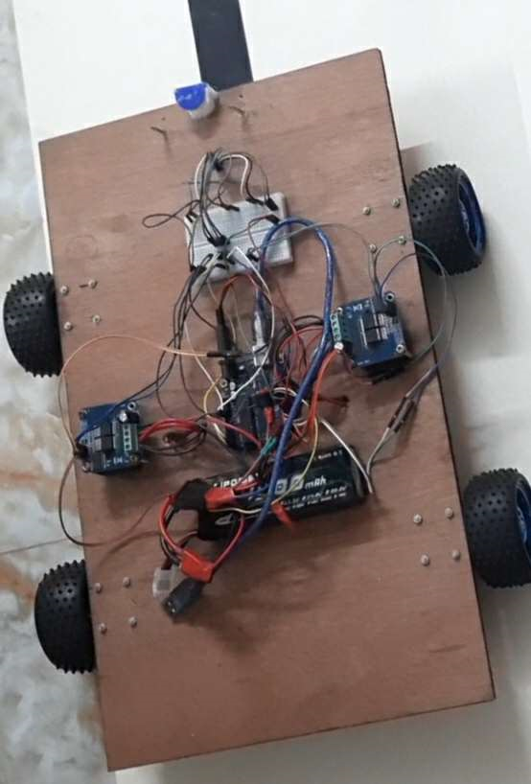
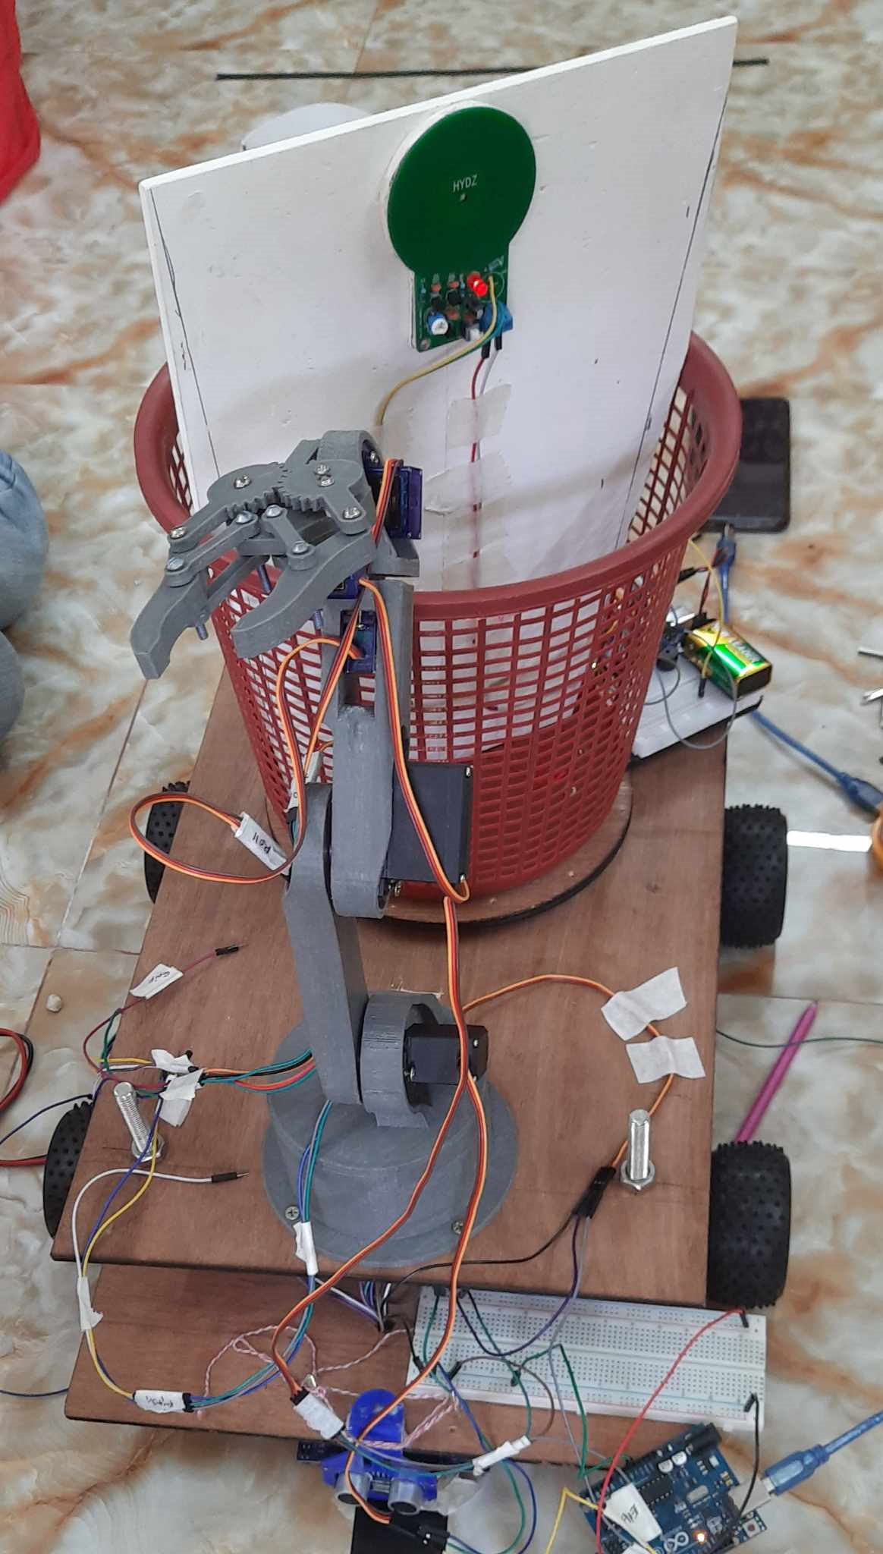
ROBOTIC CAR DESIGN (Hardware Part)
Designing the line follower robot.
Laser cutting ply-wood as per designed.
Buying and assembling necessary components.
Making appropriate connections to give power supply to every circuit component.
Connecting Arduino pins with circuit components for further software implementation.

Slide 5
ROBOTIC CAR DESIGN (Software Part)
Writing code for the bot to follow line and make appropriate turns as per necessary. When the end of line is reached , the bot spins and searches for the line to return.
While finding trash on the line at an appropriate distance , the bot automatically stops and starts moving again when the trash has been picked up.
Implementing weight balancing and speed control.
Testing and debugging to make sure the bot works properly under adverse condition of the track.

Slide 6
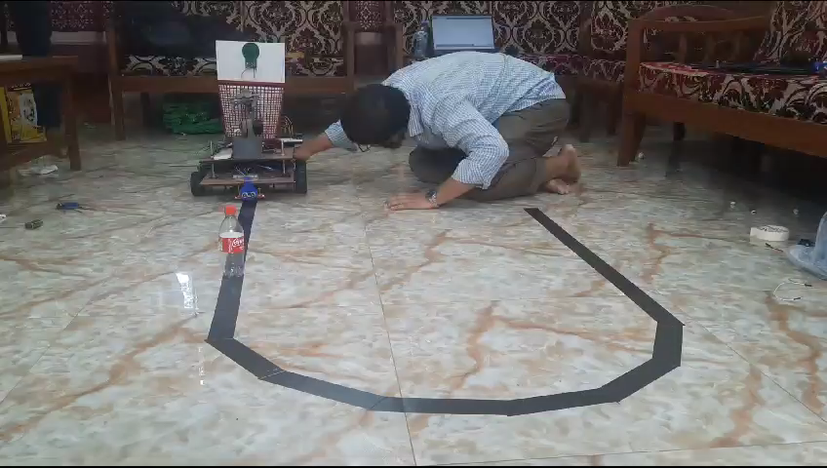
Video Demonstration

Slide 7
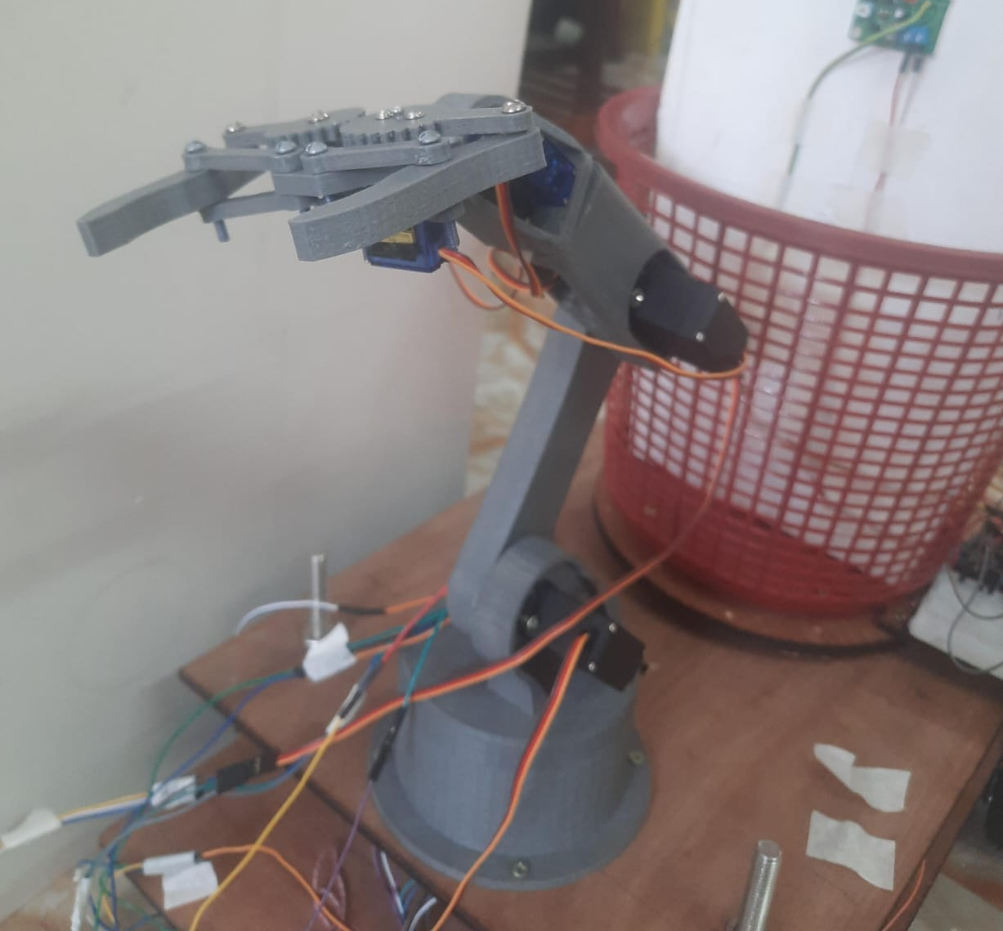
Robotic Arm Control
Pitch Servo
Grip Servo
Roll Servo
Elbow Servo
Shoulder Servo
Base Servo

Slide 8
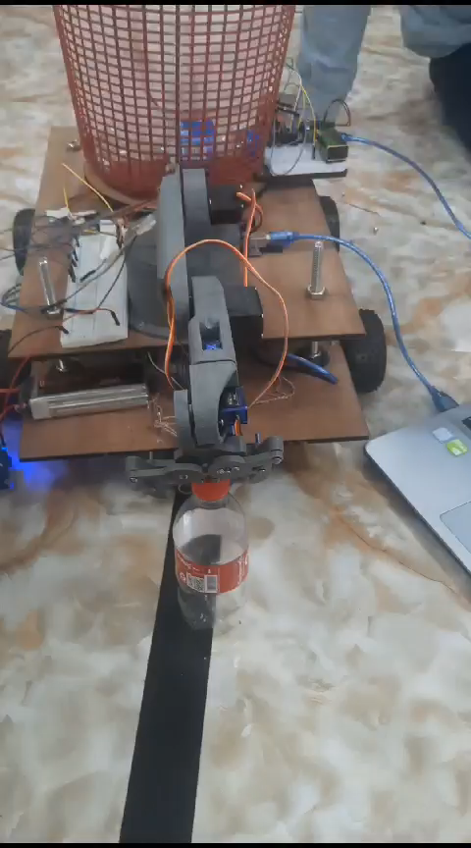
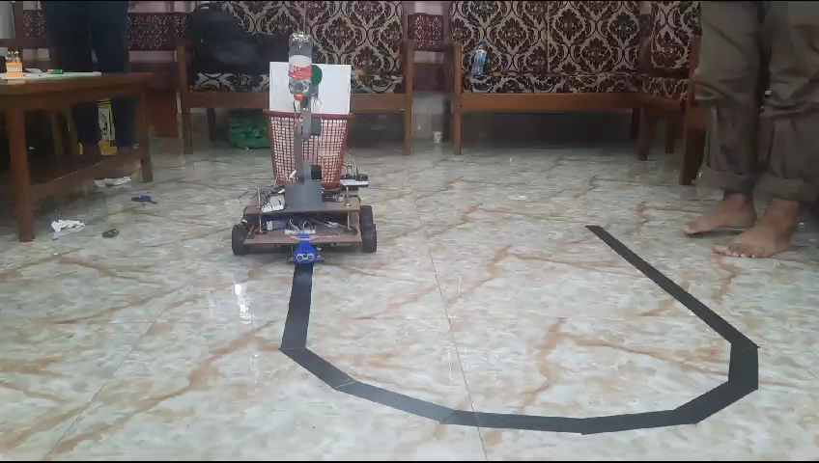
Video Demonstration

Slide 9
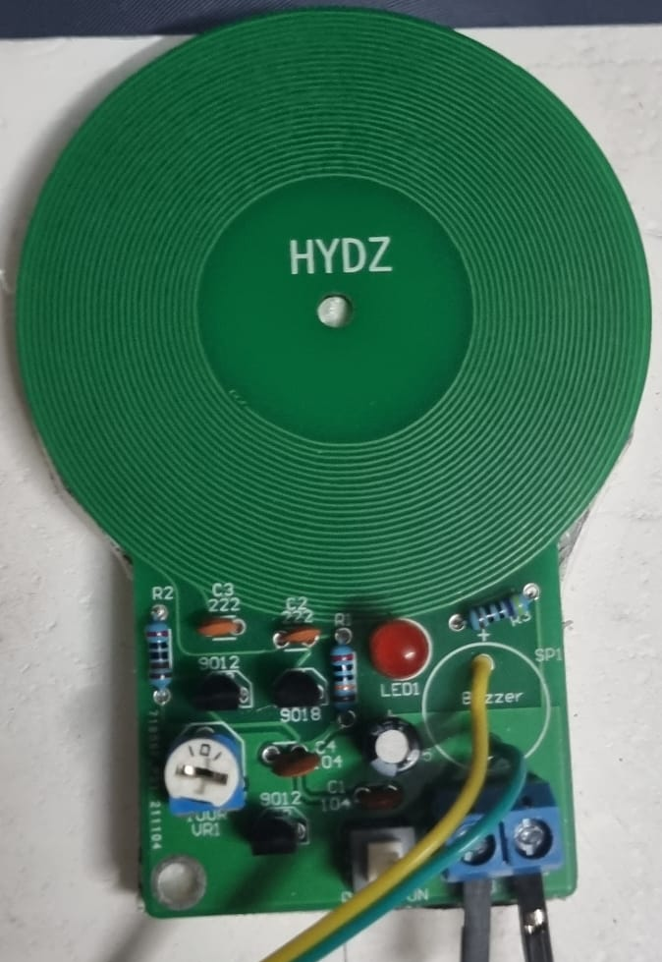
Trash Segregation (Metallic & Non-metallic)
Detection range for different objects:
Switchblade- 5 mm
Battery- 15 mm
Metal Can -25 mm
Works based on the strength of magnetic field
If Metal
Rotate 180 degree
Receive Trash
Rotate 180 degree again
Metal detector
No Rotation
If Non- Metal

Slide 10
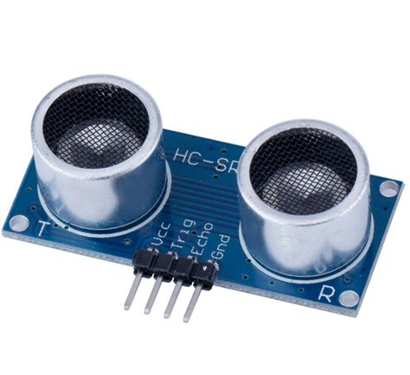
Trash Level Detection
Measure the distance to the target by measuring the time between the emission and reception
LED Blink
Detection range: 2 – 400 cm
If distance < 3 cm
Ultrasonic Sensor
If distance > 3 cm
No Change

Slide 11
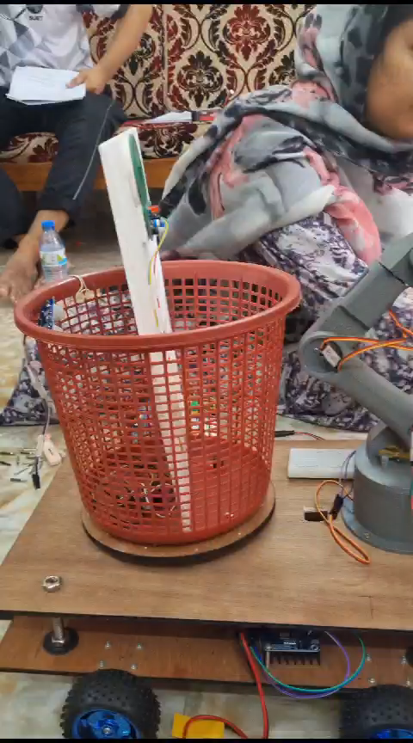
Video Demonstration

